Slide 1


Contributing to OBIS Canada
Notes:
OK, so I’m going to run through a couple of higher level things again, the different tiers of OBIS node and how to become one, if that’s an appropriate thing to do, vs lining up with OBIS-Canada. How the OBIS system nests within the Intergovernmental Ocean Commission, how the IOC data policy works, that’s mostly to make sure it doesn’t clash with any of the policies at your institutions, especially in the era where we are becoming more aware of data ownership and protection considerations such as OCAP and CARE in addition to our commitments to FAIR principles for data sharing, we may find instances where pushing data into the OBIS system for certain projects might not meet obligations you’ve made to partners or will require their buy-in or input before releasing it via the OBIS publication licenses.

Slide 2




UNESCO
United Nations Educational, Scientific and Cultural Organization
IOC
Intergovernmental Oceanographic Commission
IODE
International Oceanographic Data and Information Exchange
OBIS
Ocean Biogeographic Information System
Notes:
So, to recap some of those ingredients in my word salad, and the hierarchy of all these acronyms [read slide]

Slide 3
What is IOC?
Intergovernmental Oceanographic Commission
of UNESCO is the United Nations body for
ocean science
ocean observatories
ocean data and information exchange
Capacity development and marine technology transfer
and ocean services such as Tsunami warning systems.
Its mission is…
to promote international cooperation and to coordinate programmes in research, services and capacity building to learn more about the nature and resources of the oceans and coastal areas
to apply this knowledge to improved management, sustainable development and protection of the marine environment and the decision making processes of States.

Slide 4
"International Oceanographic Data and Information Exchange”
A program of the "Intergovernmental Oceanographic Commission" (IOC) of UNESCO
Established in 1961.
Purpose is to enhance marine research, exploitation and development, by facilitating the exchange of oceanographic data and information between participating Member States, and by meeting the needs of users for data and information products.
For more see http://www.iode.org

Slide 5
Background
OBIS is the world’s largest open access, online repository of spatially referenced marine life data that:
Nations can use to develop national and regional assessments, to discover trends, gaps and biodiversity hotspots and to meet their obligations to the Convention on Biological Diversity and other international commitments.
Stimulates research about our oceans to generate new hypotheses concerning evolutionary processes, species distributions, and roles of organisms in marine systems on a global scale.
Forms a baseline of marine life’s diversity, distribution, and abundance against which future change can be measured.

Slide 6
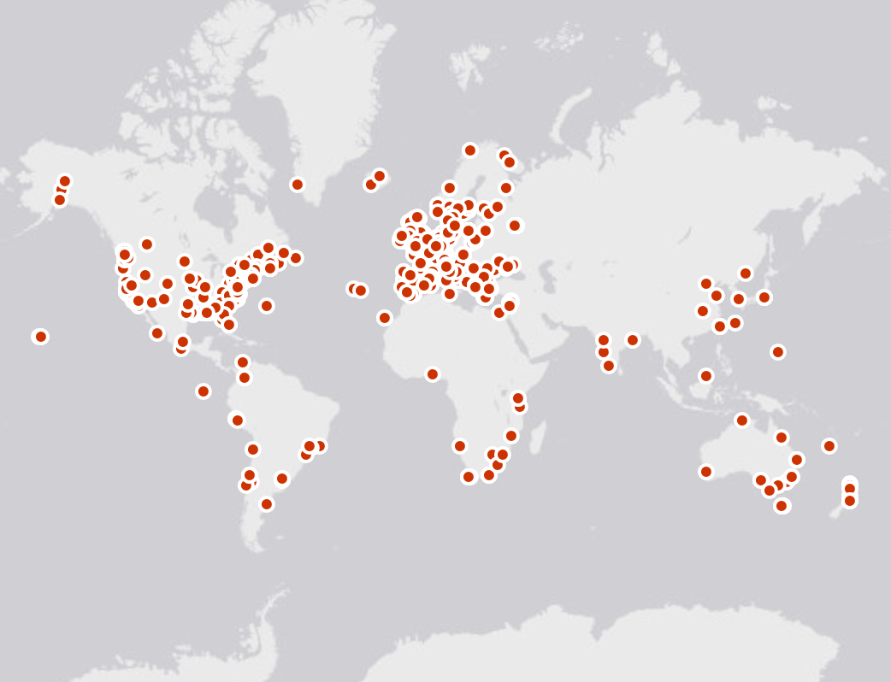
OBIS Nodes
Arctic OBIS
DeepSeaOBIS
OBIS Canada
Oceans Past
OBIS HAB
iOBIS
OTN
OBIS USA
FishBase
OBIS China
MicrOBIS
EurOBIS
Black Sea OBIS
KOBIS
OBIS SEAMAP
MedOBIS
PEGO-OBIS
OBIS Japan
CPPS OBIS
Caribbean OBIS
OBIS Senegal
IndOBIS
SEA OBIS
WSAOBIS
ESPOBIS
AfrOBIS
OBIS Australia
South Western Pacific OBIS
ArOBIS
AntOBIS
Notes:
The data from these 600+ institutions is provided to OBIS through more than 30 national, regional or thematic OBIS nodes. They standardize and quality control the data, so OBIS can easily integrate them in a single database. The central system is maintained here at the OBIS secretariat in Oostende.

Slide 7
OBIS Data Network (Nodes)
OBIS’s data network organised in a hierarchical structure of nodes
Tier 1 = OBIS secretariat at IODE
Tier 2 = Regional and Thematic Nodes (NODC’s like OBIS Canada and ADUs like OTN)
Tier 3 = Local Nodes (NODC’s and ADU’s)
Notes:
OTN – Tier 2 Node – thematically about biologging and machine observation of animal presence.
Tier 3 – local nodes, more geographically concentrated National Ocean Data Centers and Associated Data Units.

Slide 8
OBIS nodes ToR
Receiving or harvesting marine biodiversity data (and metadata) from national, regional and international programs, and the scientific community at large.
Perform data validation (using standards, tools and best practices), as described in the OBIS manual.
Reporting the results of quality control directly to data collectors/originator.
Making data (and metadata) available to OBIS using agreed upon standards and formats (OBIS cookbook).
Control data access, terms of use and sharing policies.
Provide customer support (data queries, analyses, feedback).
Increase visibility and reach out (Communication and Outreach Strategy).
Build customized portals (e.g., multiple languages).
Comply with the IOC data policy for using and sharing OBIS data.
Notes:
So, the ToR of a node is a lot like the obligations you’re already under to serve biodiversity data for your data providers. Take in data, validate it, report the results back to the originator but also make it available in useful formats, enforce the terms of use and sharing policies you’re obligated to enforce, help people access and use the data you’re expressing, assist in discovery of this data by new potential users, build portals to mirror this data to new audiences, and comply with the data policy for your organization and that your partners have agreed to. If you were an OBIS node, this policy would conform to the IOC data policy, which.. probably it already does. We’ll go over it!
So as an Associated Data Unit or an OBIS node, life would look much the same as it does now.

Slide 9
What does it mean at a technical level?
Providing multiple datasets in a standard format for harvesting by iOBIS (Darwin Core Archive format)
Having complete and good quality data and metadata for each dataset
Regular updates to the datasets where possible
IPT Server to serve the datasets (or use the IPT server of iOBIS to upload datasets)
Notes:
The extra things to take on at a technical level would be to provide datasets as DwC archives to be harvested by iOBIS, ensuring your data and metadata are of good quality according to the norms of the OBIS community (which change but not so quickly). Make updates to the datasets as they grow, and host an IPT server, or use an existing IPT service either iOBIS or your NODC, to upload your datasets.

Slide 10
OBIS-Canada

Slide 11
OBIS Node application process
If you are an existing NODC (within the IODE network) and the OBIS node activities fall under the activities of the NODC
=> Send a letter expressing your interest to become an OBIS node (including contact information of the OBIS node manager, and geographical/thematic scope of your OBIS node)
If you are not an existing NODC, apply to become an IODE Associate Data Unit (with a specific role as OBIS node)
Notes:
So there’s an application process to become an OBIS node, first you ought to be a NODC or ADU under the IODE framework, which is free, and not so much effort for organizations that are already building and aggregating data at the scale of an OGSL. I am not sure if we will all be looking to OBIS Canada and its obligations with our CIOOS hats on, or if the regions ought to all pursue ADU classification and link with OBIS Canada on those terms. This could be something we strategize about as we look to CIOOS 2.0 and the biological effort we all undertake there.

Slide 12
Terms of Reference: IODE Associate Data Units (ADUs)
IODE Associate Data Units (ADUs) shall:
Be national projects, programmes, institutions or organizations (other than NODCs), or regional or international projects, programmes, institutions or organizations that carry out data management functions,
Receive information on, and contribute to, IODE standards and best practices related to ocean data management,
Be welcomed to participate in ocean data and information management training, organized within the framework of the IODE OceanTeacher programme,
Be invited, as observers, in Sessions of the IODE Committee,
Participate in IODE workshops and projects,
Share expertise with other ADUs and NODCs,
Be invited to share their data and information on their data collection (metadata catalogue), and this should be through their NODC (in the case of national projects, programmes, institutions or organizations), or through another IODE data facility (in the case of regional or international projects, programmes, institutions or organizations) or, in the case of biogeographic data, through iOBIS,
Receive assistance, upon request, from IODE, on matters related to ocean data management,
Closely link with their IODE National Oceanographic Data Centre (NODC), if existing (in the case of national projects, organizations and institutions),
Agree to make available data management documentation (standards, practices, guides,…) used by the ADU.
Notes:
So, to become an ADU you ought to be a national, international, or regional organization that carries out data management functions. You keep up with IODE standards and contribute where you can. You aare up for taking training within the framework of IODE’s OceanTeacher programme (which is the programme under which we were certified as OBIS trainers). Send someone to sessions of the IODE committee, participate in their workshops, be willing to share your expertise with the other ADUs and NODCs. Share your data up through your

Slide 13
What are the benefits for ADUs?
Being associated with IODE means the following:
You will have access to IODE documentation and expertise in the area of oceanographic data management and marine information management;
You will be part of the IODE information dissemination network related to oceanographic data management and marine information management;
You will be able to obtain IODE (OceanTeacher) technical training related to oceanographic data management and marine information management
You will be invited to make your data and information available through relevant IODE mechanisms (e.g., OceanDataPortal, OceanDocs, OceanExpert, OBIS,…)
You will be invited to participate in IODE projects
You will be invited to designate experts to participate in IODE project steering groups or IODE groups of experts (short-term members).

Slide 14
How to become an ADU/OBIS Node..
IODE invites any project, programme, institution or organization that is willing to comply with the Terms of Reference to apply to join IODE as an IODE Associate Data Unit (ADU) by providing the following information (sent to p.pissierssens@unesco.org with copy to info@iobis.org) :
Name and contact information of the ADU contact point(s).
Name and contact point of the head of the applicant entity.
Description of the national, regional or international project, programme, institution or organization.
Brief description of data services/products provided by the entity.
For projects: expected lifespan of the project and indication of plan for the archival/preservation of the data, data management plan.
Letters of support.
Required expertise, training that IODE could contribute.
Data policy (if identified) of the applicant entity.
Details of any existing relationship with an NODC.
ADU form available HERE
https://bit.ly/2Rsjz4V

Slide 15
Once your application is received…
Applications for ADUs will be reviewed by the IODE Management Group in consultation with the OBIS Steering Group.
Once approved, you will be notified and the OBIS node manager and data manager will be added to the OBIS Steering Group

Slide 16
OBIS Node health status check;
transition strategy for inactive OBIS nodes
SG-OBIS evaluates the health status of OBIS nodes at each annual SG meeting
An OBIS node is considered inactive when it meets any of the following conditions:
The OBIS node manager recurrently fails to answer the communications from the project manager or the SG co-chairs in the last 12 months
The OBIS node manager or a representative fails to attend (personally or virtually) the last 2 SG meetings without any written reason
The OBIS node does not have an IPT
The OBIS node has an IPT, but it has not been running for the last 12 months
The datasets in the OBIS node's IPT have been removed and not restored in the last 12 months (without any explanation)
The OBIS node has not provided new data for the last 2 years
Notes:
So OBIS’s steering group evaluates the health of its Nodes at each of the SG meetings, and an OBIS node gets ticked over to inactive when it meets any of these conditions:
[ read slide ]
so you’ve got to keep in touch with the community, often on your own dime when it comes to attending the meetings and infrastructure, and be keeping your data portal active and running and have new data flowing through it.

Slide 17
OBIS Node health status check and transition strategy for inactive OBIS nodes
SG-OBIS
Option 1: submit action plan
OBIS node
OBIS node
OBIS node
IODE
Option 2: recommend to IODE removes OBIS node
Notes:
The SG-OBIS members representing active OBIS Nodes will make one of the following decisions:
Request the inactive OBIS node to submit a plan with actions, deliverables and times to improve their performance, within 3 months, to the OBIS Secretariat. This plan is reviewed and accepted by the OBIS-Executive Committee
Or
Provide a recommendation to the IOC Committee on IODE to remove the OBIS node from the IODE network.
In either case, the OBIS Secretariat will inform the OBIS node manager of the SG-OBIS decision, with a copy to the IODE officers and the IODE national coordinator for data management of the country concerned.
The IODE Committee is requested to consider the recommendation from the OBIS Steering Group and it may either accept the recommendation or request the inactive OBIS node to submit an action plan (option 1).
When the inactive OBIS node is removed from the IODE network, the SG-OBIS will ask whether another OBIS node is interested in taking over the responsibilities of the removed OBIS node, until a new OBIS node in the country/region is established.

Slide 18
Summary:
The OBIS Network needs additional nodes to help improve coverage both geographically and thematically.
Every institution, project, initiative can apply to become a node of OBIS (TIER II or III) as an NODC or ADU recognised by IODE.
Notes:
So the big recruitment take-home here, OBIS needs more nodes, whether they are National Ocean Data Centers or Associated Data Units.

Slide 19
OBIS Contact Information
OBIS Canada
Node Manager: Maria Cornthwaite
Email: OBISCanada@dfo-mpo.gc.ca
Ocean Tracking Network
Node Managers:
Jonathan.Pye@dal.ca
Lenore.Bajona@dal.ca
OBIS Secretariat
UNESCO-IOC Project Office for IODE
Wandelaarkaai 7/61, 8400 Oostende, Belgium
Project Manager: Mr Ward Appeltans
Phone: +32 59 34 01 76
Email: w.appeltans@unesco.org
Notes:
If that’s of interest to you, you can find Ward’s contact information on the IODE website, but here it is here as well. He’s been a wonderful resource for us at OTN as we navigated this process, and it has done wonders for our bona fides in the ocean community to be contributing to this initiative.
Questions? OTN went through this process back in 2016 and so I can relate some of what we had to do and what the benefits have been so far.

Slide 20
OBIS guidelines on the sharing and use of data
Notes:
So, one of the requirements for OBIS nodes is to follow IOC data policy guidelines. So let’s go over what those are.

Slide 21
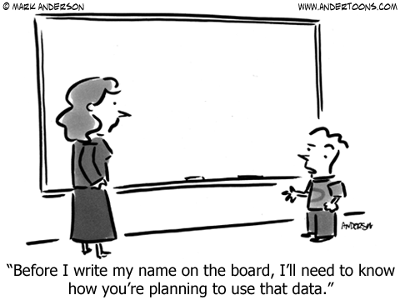
Notes:
We live in an era of rampant personal data misuse, and I don’t know what your experience is with data providers, but they’re very interested in how and where their data will be shared.

Slide 22
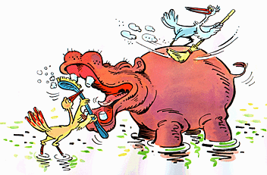
Data Manager & Researchers
Notes:
Ideally, our role as data managers and infrastructure providers would be symbiotic and beneficial to all involved. We provide a valuable service to the research community, and that community benefits from the increased reliability, quality control, archival and discoverability that good data management groups can offer them, both in writing grants and in

Slide 23
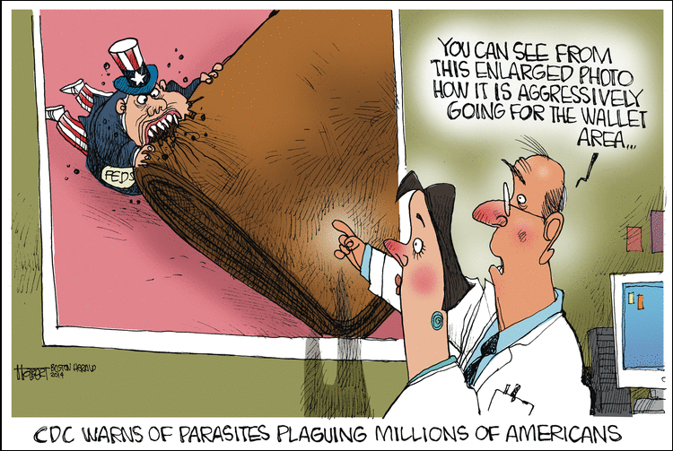
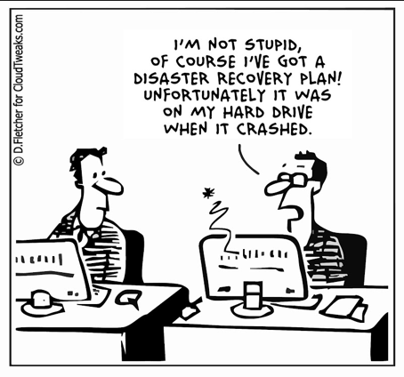
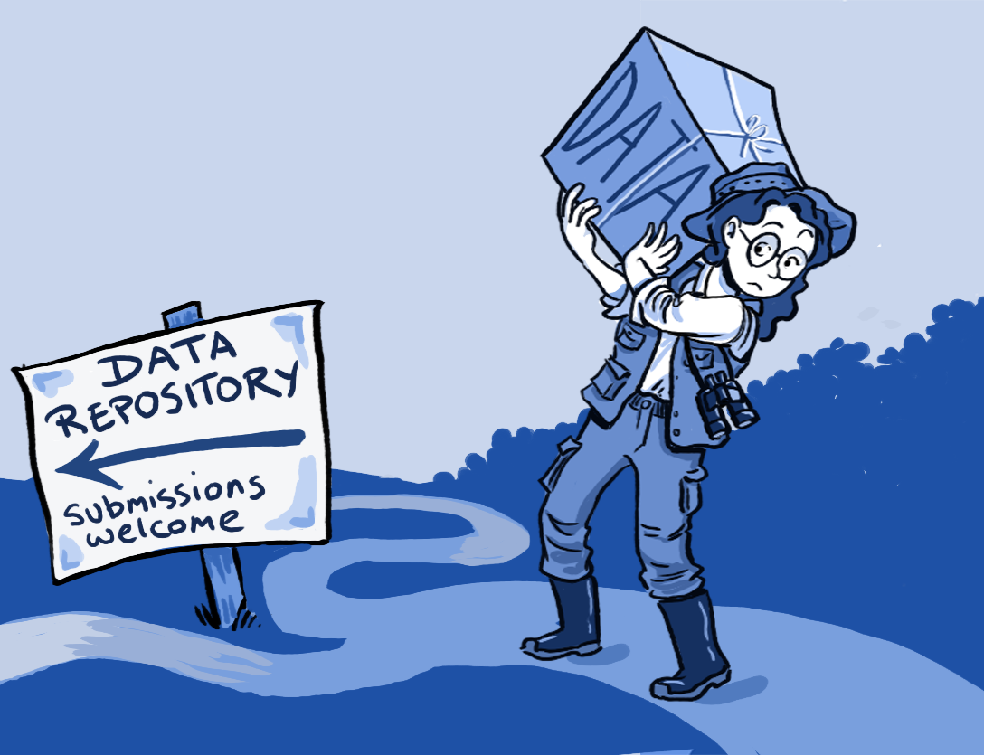
The reality…
Notes:
In reality, researchers can see data management as an extra cost they’re not used to paying for, [click] and data managers see the precariousness of throwing millions of dollars into a research programme without any idea of how the outputs will be protected and shared with the public. [click]. Ideally, we’d be viewed as a crucial resource, a way for researchers to unburden themselves of having to curate and advocate for their data after they have collected and analyzed it.

Slide 24
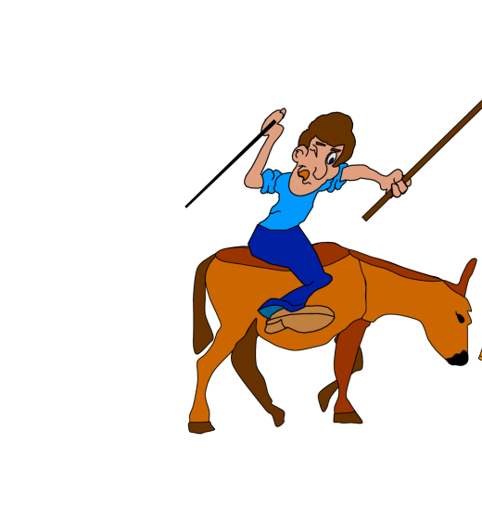
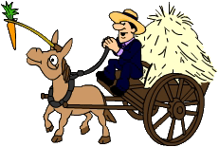
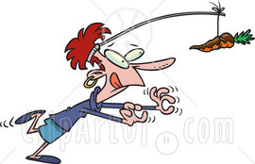
Data sharing
The sense and non-sense of data sharing…
How to convince data custodians to share their data?
“Stick”
Legal obligations written into contracts
“Carrot”
Make it advantageous for everyone to share data
=> breaking the prisoner’s dilemma
Notes:
For disciplines that have not undergone the data sharing revolution, there’s the added requirement to convince or constrain data providers to share their data with the public at all! Oceanographers see a plain public benefit to their data becoming public, but this was not always the case. So either we find a stick to beat them into compliance, that’s contracts or grants that require data sharing, or we find the carrots that will entice them to share. There is a bit of a prisoner’s dilemma at play in fields of study where sharing is not the norm.

Slide 25
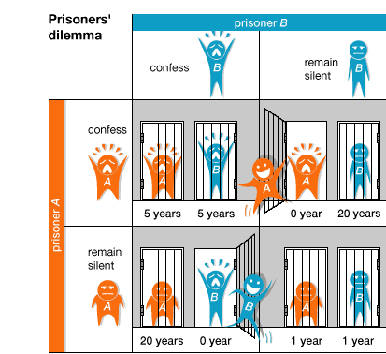
The prisoners’ dilemma
Best choice => both stay silent (= both serve 1 year)
BUT: no guarantee that the other one will remain silent!
Actual outcome => “rational choice” is to betray or ‘cheat’ on companion
Notes:
And,if you need a recap of what the prisoner’s dilemma is, it’s the idea that if one person acts a certain way while the other does not, they put themselves at a disadvantage. For prisoners, this means staying silent vs. confessing to a crime. If all confess, they get larger sentences than if none do, but if only one confesses, and the other doesn’t, the one who doesn’t confess faces a huge disadvantage!
In this analogy, sharing data is equivalent to remaining silent. Confessing, or ratting out your friend, is equivalent to hoarding your data. Somewhat confusing, stay with me!

Slide 26
“Cheater” earns the highest rewards:
Scientist A & B each have a dataset
A shares data, B doesn’t
B can write papers on combined dataset, A can’t
How to break the prisoner’s dilemma?
Building up trust relationships
Provide in good data policies
Increase advantages of data sharing / data publication
Citation of datasets
Co-authorship
Data sharing = iterated prisoner’s dilemma
Notes:
So the cheater gets the reward if he’s the only cheater. But if nobody cheats, everyone is better off in aggregate. If we all share, everyone gets the benefit! So how do we discourage cheaters? Build trust between ourselves and our providers, provide good data policies that tell the providers what they can expect, and enhance the advantages for data sharers. Increased citations, co-authorships, data papers.

Slide 27
IOC oceanographic data exchange policy
Adopted by Resolution IOC-XXII-6 (2003)
http://www.iode.org/policy
IOC programmes:
Clause 1: Member States shall provide timely, free and unrestricted access to all data, associated metadata and products generated under the auspices of IOC programmes
Other programmes:
Clause 2: non IOC programmes are encouraged to apply clause 1
Clause 3: encourage clause 1 and 2 for non-commercial use (research and education)
Clause 4: right to determine the terms, in a manner consistent with int conventions
Clause 5: archive your data in NODCs, etc.
Clause 6: Member States shall build capacity in developing countries
Notes:
So those are our motivations when we write data policy. We want to break this prisoners dilemma, and push people onto the virtuous path of data sharing by carrot, because we don’t have any sticks. The funders have sticks, and if they know about our carrots they can use those sticks on our behalf but I’m getting too into these metaphors.
The IOC data policy for IODE, member states shall provide timely, free and unrestricted access to all data, metadata, and products generated under IOC programmes. There’s a big stick! This creates a class of behavior at the highest level to share data. Clause 2 – boils down to if you’re not under the IOC mandate, you should still apply clause 1 if you can! No stick here, just wishing. Clause 3 – the IOC encourages clauses 1 and 2 for all non-commercial applications. That puts a stake in the ground for funding bodies for those groups, here’s the standard for nations and international programmes. Shouldn’t your grantees meet it? Clause 4, keep the terms of compliance within the conventions of the international community, basically allow for edge cases and equitable dealing across different levels of capacity. Clause 5, encourages the behavior we covered earlier, providers should use their NODCs and ADUs where they find them. Clause 6, we should work to build capacity in developing nations.

Slide 28
OBIS license?
OBIS does not own the data (the data providers retain ownership of the data provided), but OBIS has been given the rights to publish/distribute the data via its online open-access data portal.
The integrated OBIS database is a new product created by OBIS, now under the auspices of IOC-UNESCO. This means that clause 1 of the IOC data exchange policy applies: OBIS shall provide timely, free and unrestricted access to all data, associated metadata and products.
Notes:
OK so how does this apply on the OBIS level? OBIS doesn’t take ownership of data provided to it, but has been granted the right to publish/distribute it via its portal (the Integrated Publishing Toolkit).
This –new- product, the OBIS database, lives under IOC-UNESCO, and is therefore subject to Clause 1. OBIS will provide timely, free and unrestricted access to all that data, metadata, and associated products.

Slide 29
Dataset use constraints
High variety of restrictions on the use of OBIS datasets
From no restrictions:
No information or just a weblink or disclaimer;
Commercially available, to:
To more severe restrictions:
Freely available if cited (4 levels: record, dataset, OBIS node, OBIS);
Include co-authorship in case a substantial amount of the data is used;
Do not use without permission;
Do not use for commercial purposes without permission;
Do not redistribute to third parties without permission.
Notes:
On a per-dataset level, the provider retains a good deal of control over what that means in practice.
From no restrictions at all – that means no need for accreditation or provenance, and the ability to use it commercially, all the way through to more severe restrictions, attribution-required, co-authorship for substantial data usage, by permission only, no commercial, and no redistribution.
Everything covered by the Creative Commons family of licenses is permitted to be attached to datasets individually, and additionally the right to redistribute can be restricted.

Slide 30
Implications?
Citations, co-authorship, non-commercial use and explicit permissions…
How can we enforce, control, monitor, police violations?
=>not the responsibility of OBIS
=>aren’t we making it impossible to use data from OBIS?
=>is allowing these restrictions just a way to convince scientists to provide their data?
Notes:
Attaching licenses to these datasets doesn’t create obligation on the part of OBIS or your part, when you’re publishing data with licenses you are asking the end users to respect your terms, but they’re never obligated to do so. So why do it? Are we just trying to make scientists feel better about giving us their data? It certainly has that effect, but I think there are reasonable use cases for all the CC classes certainly, and I can understand the desire not to see data redistributed without control.

Slide 31
Which license should we promote?
For OBIS, as a data aggregator, it would be a lot easier if the whole community accepts a single, clear and open license that allows maximum use of the datasets.
Creative Commons Zero (CC0) license
With CC0 you waive any copyright you might have over the data(set) and dedicate it to the public domain
Users can copy, use, modify and distribute the data without asking your permission.
You cannot be held liable for any (mis)use of the data either.
Notes:
OBIS has made the decision to encourage the use of CC-0, it’s maximally permissive for data users, doesn’t put too many restrictions on them, and keeps liability away from data providers. So they’re encouraging their contributors to adopt that license wherever possible.

Slide 32
Which license should we promote?
What about attribution?
Although CC0 doesn’t legally require data users to cite the source, it does not take away the moral responsibility to give attribution, as is common in scientific research.
There is no license attached to scientific papers that says you have to cite the paper when used, but it is common practice in science.
Notes:
Attribution’s not covered in CC-0, but there’s still a moral responsibility for researchers to credit the data they use when writing papers and producing reports. And to that point, there’s no license on papers you read that say if you use the idea you have to cite it when you use it in non-academic ways, but there’s a powerful convention and history in the community that enforces that idea, and it works out.

Slide 33
What license for the OBIS database?
The OBIS database, and any products are published under the Creative Commons Zero (CC0) license.
Promote fair use…
Encourage people to build applications using the data access webservices, rather than maintaining a copy of OBIS
Respect the data providers, and provide helpful feedback on data quality.
When you are both a data user and a data custodian yourself, you should also publish your data to OBIS
Consider sponsoring or partnering with OBIS and its OBIS nodes
Notes:
So, given all that, the OBIS database itself is distributed under CC0. people can build applications using the webservices instead of seeking local copies for the sake of reliability. OBIS encourages users of the data to respect the data provider and give feedback on data quality. When you wear both hats, as a data user and a custodian, you should set a good example and publish your own data to OBIS. And if you’re in a position to do so, and you find OBIS useful and good, you should sponsor or partner OBIS or its nodes where you can. This includes maintaining an OBIS node.

Slide 34
Good advice: Develop a Data Policy in your institution
A data policy should contain:
Identify the data use license, preferably based on Open-access principles (you can refer to the IOC data policy)
Describe fair use
Describe your needs
Describe data ownership
Provide disclaimer
Provide citation guidelines
Notes:
I don’t need to preach this one for you folks, we know the benefits of our data policy, but we encourage every institution we interface with to develop data policies, with associated licenses if applicable, covering the appropriate use of the data they collect, the obligations to the data provider that will allow the provider to benefit from or receive credit for the use with the appropriate parties, describe data ownership, provide any disclaimers necessary, and give guidance on citing the data properly.

Slide 35
“Advice to a Young Investigator” (1897):.
“A scholar's positive contribution is measured by the sum of the original data that he contributes. Hypotheses come and go but data remain.”
Santiago Ramón y Cajal
(Nobel Prize winner in 1906)
Notes:
We are what we leave behind. This is a wonderful quote [read it]. I have heard it expressed in other ways, less kindly, as i’ve heard it shouted across a room during a data policy meeting ‘What do you think is going to happen to your data when you die!?’. God, that was a really good meeting.
Any questions on the IOC data policy? I’ll do my best. If we just want to talk about it for a minute or two we have a good opportunity to do so now.

Slide 36

OBIS metadata standards
Notes:
OK, now let’s cover off EML and how it relates to the metadata you’re probably handling already.

Slide 37
Metadata standards
OBIS (and GBIF) uses the Ecological Metadata Language (EML), in more particularly the GBIF EML profile (version 1.1), as its metadata standard.
The Integrated Publishing Toolkit (IPT) developed by GBIF provides an online interface to manually fill in the EML terms.
OBIS Manual: https://obis.org/manual/eml/
Notes:
So OBIS uses the GBIF EML profile just as it uses the GBIF-authored Integrated Publishing Toolkit. There’s a manual on the details of the eml standard, but a useful way to get hands-on with this metadata language, and to get things into EML as a layperson, is to use the IPT directly to fill in the EML terms.
The first thing you’re going to see on that manual page is that they have a mapping from ISO 19115 to EML 1.1. That could be a good starting point for us during the hands-on sessions, figuring out how to leverage that mapping to quickly have a bash at EML versions of all the biodiversity metadata that I’m sure you’re expressing as ISO 19115 right now.

Slide 38
Metadata standards
EML TERMS
Title
Abstract
Contact
Citation
geographicCoverage
temporalCoverage
taxonomicCoverage
purpose
methods (sampling, QC)
project
keywords
Required by OBIS
Notes:
OBIS only needs a few of the terms in EML to build a project repository. Title, Abstract, Contact, Citation. You have those, you can build an archive. It will be a very undiscoverable archive but you’ll have it. For most things, you’ll also have geographic, temporal, taxonomic dimensions, and some idea of the how and the why of a project, as well as some keywords that people might be using when looking for data of the kind in this repository.

Slide 39
Metadata standards
Dataset title
Is different from the shortname (which is used to create the DwC-A file and the dataset IPT URL
A good, descriptive title is indispensable
Provides users with valuable information, making e.g. data screening easier
Originally received | Recommended title, to be checked with provider
Biomôr | Benthic data from the Southern Irish Sea from 1989-1991
Kyklades | Zoobenthos of the Kyklades (Aegean Sea) from a survey in 2009
Benthos_NS | The macrobenthos of the North Sea
Dataset_1 | Meiofauna of Madagascar
Dataset_for_OBIS | Fish collected during a 3-month survey in the national waters of South Africa in 1975
…
Notes:
OK so titles vs. shortnames. Shortnames are like Wordpress slugs, they are unique and used for the filename of the archive itself and the IPT url. Titles are descriptive and contain human-readable words that you can use to guide people to the right datasets. So where your shortnames might look like this [click], you want your titles to be more like this [click]

Slide 40
Metadata standards
Abstract
The abstract or description of a dataset provides basic information on the content of the dataset. The information in the abstract should improve understanding and interpretation of the data.
It is recommended that the description indicates whether the dataset is a subset of a larger dataset and – if so – provide a link to the parent metadata and/or dataset.
If the data provider or OBIS node require bi- or multilingual entries for the description (e.g. due to national obligations) then the following procedure can be followed:
Indicate English as metadata language
Enter the English description first
Type a slash (/)
Enter the description in the second language
Notes:
One level above shortnames (though there’s some of us who have longnames in between) is the abstract. Describes the dataset, the content, and generally should help a user understand and interpret the data inside. It’s a great place to tell users if this dataset is a subset of a larger project, say, if an eel tracking dataset was part of the Ocean Tracking Network’s Canadian research initiative. You can link to parent datasets and external information. As some of us find it useful to be descriptive in multiple languages, if you want to write multilingual abstracts, you can add abstracts in more languages separated by slashes. OBIS asks for English as the first in the list, but I don’t know why or what consequences that might allude to.

Slide 41
Metadata standards
Contact
Publisher (institution)
Contact (person + institution)
Creator (person + institution)
Associate party (person + institution)
Originator
Content provider
Principle investigator
Custodian steward
Owner
Point of contact
..
Notes:
You can provide a set of contacts in EML, and associate institutions, personal details, their role within the project, how they’re affiliated to it.

Slide 42
Metadata standards
Citation
Comparable to a publication reference
Should contain:
Authors (e.g. data collectors, responsible researchers, data managers, …)
Publication year
Dataset title
Name of the organizations involved when different from publisher
Publisher (can be the OBIS node)
Dataset type (e.g. occurrence, sampling event)
Version number
IPT dataset url
Note: IPT has an option to auto-generate the citation based on the metadata.
Notes:
You can add guidance on proper citation here, authors, publication year, title of the dataset, if you don’t want to be specific about it the IPT will generate one for you, or if you have other obligations, like we did, you can figure out how to auto-generate your own conformant citation and supply it here.

Slide 43
Metadata standards
Data paper
Fill in as much metadata as possible and publish your metadata as a data paper e.g. in a Pensoft journal, by importing the eml.xml file into their arpha tool.
Instructions: https://arpha.pensoft.net/tips/From-GBIF-IPT-metadata-EML
Notes:
OK, so this is generally where data collecting individuals taking OBIS training are encouraged to pick up their own datasets and try and mold them into a data paper using Pensoft or some other open publishing journal to prove the utility of the eml.xml metadata file and the DarwinCore archive. We don’t have to do that, but I suggest that as we jump into our hands-on work this afternoon, we think about what sorts of things would be most useful in an auto-generated EML file and associated dataset and what do we want our data providers to be able to do with this information?

